Slide 1

International Academy of Commercial and Consumer Law
Online Conference 14 & 15 July 2021
COVID-19 related public and private measures as a type of impediment under the CISG?
Prof. Edgardo Muñoz

Slide 2


COVID-19 was declared a pandemic by the World Health Organization on 11 March 2020 and since then it has generated a lot of issues in international trade, transport of goods and financial services.
Many countries are now know experiencing a third wave of infections caused by new virus variants!

Slide 3


COVID-19 massive infections, the restrictions imposed by governments and/or self-imposed precautionary measures could seriously affect both sellers’ and buyers’ ability or capacity to perform.
Eg.
Partial or total closure of non essential businesses
Reduce personnel presence in facturies
Continuous testing of employees
Stay at home rules
Imposed quarantine, etc.

Slide 4
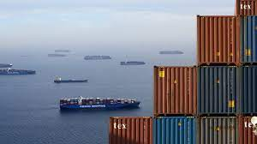

Common contractual breaches connected with COVID-19:
Delayed delivery (supply of goods);
Delayed discharge;
Delay in the availability of contractual documents eg documents representing the goods and LCs.
They can combined and lead to COMPOUND DELAYS.

Slide 5

Whether a pandemic or related measures qualifies as an ‘impediment to perform’ should be evaluated in its contractual context on a case by- case basis.
The declaration of pandemic by governments and the regulations enacted to contain the spread of COVID-19 may be the root cause of a contractual breach.
However, a failure or delay in performance is often the consequence of a chain of events caused by the global circumstances

Slide 6

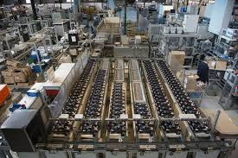
Supply chains example
Factory X produces circuit boards. Factory X supplies Factory Y - the maker of 50,000 Smart TVs per month, which in turn supplies Z - a large retailer of electronic products. One of the employees of Factory X tests positive to COVID-19. The law of the Country in which Factory X is located imposes a precautionary 15 days shut down of every factory, plant or office with reported COVID-19 cases.
Factory X has to shut down and suspend production. Factory Y has 10 employees affected by the pandemic but the law of the Country where its plants are based only requires personal isolation and testing. Production of the Smart TVS could go on, but without circuit boards contracted with X.
Z decides to suspend production instead of going out to the market an buy substitute circuit boards which price exceed now 100% the agreed price with X.
Z does not received the Smart TVs when agreed and cannot deliver them to its customers.

Slide 7

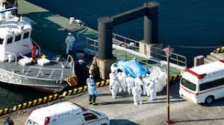
Delayed shipment example
X sells a container of frozen berries to Y on CIF Incoterms 2020, shipment period July 2021. The ship on which the container is booked to be loaded arrives on schedule on 25 July 2021 but is delayed as one of the crew members has a fever and local COVID-19 legislation imposes testing for the whole crew.
Tests come back negative, but the vessel has been delayed for three days. By the time it starts loading, port handling facilities have been reduced and loading takes longer than usual. As a result of this, the bill of lading is issued on 1st August 2021, 7 days later than expected.
Shipment in August is a breach of the sale contract that implied that time was of the essence and, in principle, the buyer may elect to avoid the contract and sue the seller for damages.

Slide 8
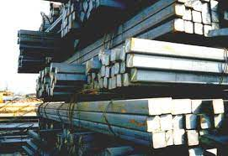

Documents/sales in transit example
W sells 10,000 tons of steel billets to X on FOB Incoterms 2020. X charters the ship and arranges the loading operations. The cargo is shipped and the vessel sails. In the meantime, X sells to Y who in turn sells the goods to Z on CIF Incoterms. X’s bank works at a reduced capacity due to the parent bank COVID-19 stay at home international rules and the flow of documents is delayed beyond the expiry of Z’s letter of credit.
In the meantime, the ship arrives at the discharge port and Z has no bill of lading to collect the cargo since X has not deliver it to Y. Laytime under the carriage contract is running and Z, worried about the pandemic’s further official restrictions, decides to avoid the contract for Y’s failure to tender the shipping documents on time.
Bank employee working from home

Slide 9
The consequences of such events are to be found in the relevant contract and the law applicable to it.
COVID-19 related public and private measures as a type of impediment under the CISG?
The CISG endorses the principle of party autonomy that enables the parties to deal with unforeseen impediments and the change of circumstances caused by COVID-19 as they deem fit.
The CISG also contains default rules that strike a fair balance between pacta sum servanda and impediments to perform, i.e. the interests of obligors and obligees affected by COVID related measures.

Slide 10



Particularly relevant:

Slide 11
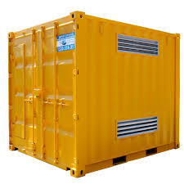
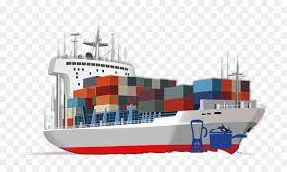
The first issue is which party is affected by the COVID-19 measure because under the contract it has to bear the risks and costs.
Depending on the Incoterms agreed
Risk of Price
Maintains all remedies against the seller
Passing of risks
Seller
Buyer
Point and time of delivery

Slide 12
Lets take the seller as example:
A seller who is delayed in delivering the goods on the agreed time and place will bear the monetary consequences of its breach unless:
1. It has catered for such occurrence(s) in the sale contract;
2. It can rely on a force majeure or hardship clause in the contract;
3. It can rely on a force majeure and/or hardship exemption from liability contained in the law applicable to the contract: the CISG.
The same applies to the buyer’s who is delayed in paying (or taking measure to pay) the purchase price.

Slide 13
1. It has catered for such occurrence(s) in the sale contract.
Eg. The contract provides for:
Alternative times for delivery
Alternative point of delivery
Option to skip one or more delivery with the option to compensate or resume at a later time.
Right to cancel orders.
This type of agreements are possible under the CISG (Art. 6).

Slide 14
2. The ‘event’ is a force majeure or hardship event as provided in the contract
Eg. ICC Force Majeure and Hardship Clauses 2020 (Allowed under Article 6 CISG).
First step: establish whether the event which occurred is covered by one or more of the express exclusions;
eg. Government measures, COVID-19 infections, delay in ports, reasonable precautionary measures?
Second step: determine what effect the parties intended the event to have on the affected party’s contractual obligation;
Eg. Automatic modification of the contract, renegotiation, cancellation, limitation of liability?
This is determined by contract interpretation pursuant to Article 8 CISG.

Slide 15
3. The applicable law to the Contract: CISG
Article 79 CISG
(1) A party is not liable for a failure to perform any of his obligations if he proves that the failure was due to an impediment beyond his control and that he could not reasonably be expected to have taken the impediment into account at the time of the conclusion of the contract or to have avoided or overcome it or its consequences.
Hardship can be considered as a special group of cases under the general impediment provision in Article 79 CISG
Two CISG Advisory Opinions contribute to the correct understanding of this provision:
CISG AC Opinion No. 7, Exemption of Liability for Damages Under Article 79 of the CISG (Rapporteur: Professor Alejandro Garro) 12 Oct 2007.
CISG AC Opinion No. 20, Hardship under the CISG (Rapporteur: Professor Edgardo Muñoz) 4 February 2020.

Slide 16
Requirements under Article 79 CISG:
The event must be beyond control
The event must be unforeseable
The event that cannot be avoided or overcome
The assessment is very much fact based!

Slide 17
The event must be beyond control
COVID-19 Infection vs Measures against COVID-19
Unforeseeable illness, absence or death by the promisor or key individuals in their corporation may not amount to an impediment beyond control since according to trade usages, such events are part of an organization’s sphere of risks.
Difficult questions arise when such illness, absence or death are due to a pandemic like COVID-19.
It could depend on whether it was caused by the lack of minimum COVID-19 preventive mesures?
Art. 7 CISG may require uniformity in the assessment of what are minimun preventive measures and thus integrate as standard international regulations.

Slide 18
The event must be unforeseable
Existing and future obstacles caused by the COVID-19 pandemic may no longer be unforeseeable for contracts concluded today.
Difficult cases involved new or existing measures taken as a result of the COVID-19’s pandemic evolution that the parties could have foreseen.
Eg. Delta Variant and the next expected waves.

Slide 19
3. Event that cannot be avoided or overcome
Seller’s own supplier’s breach due to COVID-19 related measures or events is considered something that can be avoided or overcome by turning to another supplier or considering alternatives.
Difficult cases: a party self-imposed COVID-19 “precautionary measures” which are higher from the ones imposed by the local government (but that are in line with international standards).
Can those precautionary measures be invoked?
Is there a way to incorporate them into the CISG Contract, for example, in the same way that some ethical standards are incorporated into the goods in some scenarios.

Slide 20
Consequences of an impediment to perform under Article 79 CISG.
A failure to perform amounts to breach under the strict liability principle and, therefore, the creditor :
may suspend performance (Art. 71 CISG),
may reduce the contract price (Art. 50),
may avoid the contract (Arts. 48(1) and 64(1) CISG) or any of its installments (Art. 73 CISG),
may claim interest (Art. 78 CISG) or expenses incurred in the preservation of the goods (Arts. 85 and 86 CISG).
Art. 79 (5) CISG. Nothing in this article prevents either party from exercising any right other than to claim damages under this Convention.

Slide 21
UNDER THE CISG
There is NO obligation to renegotiate the Contract;
NO possiblity to unilateraly change its terms;
A court or arbitral tribunal may not adapt the contract in case of an impediment including hardship;
A court or arbitral tribunal may not bring the contract to an end in case of hardship an impediment including hardship.
Art. 79 (5) CISG. Nothing in this article prevents either party from
exercising any right other than to claim damages under this Convention.

Slide 22
Thank you very much!
Prof. Dr. Edgardo Muñoz
emunoz@up.edu.mx

