Slide 1
New Regulation on Digital Platforms in Japan
Trading on Internet Platforms and Liability of Platform Operators
Kunihiro Nakata,
Ryukoku University, Faculty of Law (Kyoto, Japan)

Slide 2
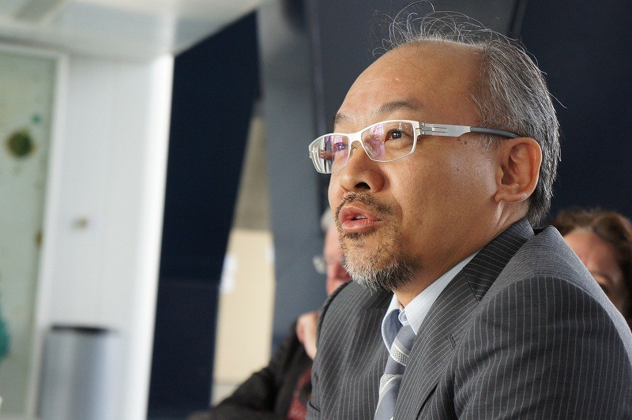
Self-introduction
KUNIHIRO NAKATA,
Professor of Ryukoku University, Faculty of Law (Kyoto, JAPAN)
Research Fellow of the German Academic Exchange Service (DAAD) Research Fellowship Program 988-90. Visiting scholar at Max-Planck-Institute for International and Foreign Private Law in Hamburg, GERMANY for many times, and invited Professor at Vienna University, AUSTRIA.
Member of the International Academy of Commercial and Consumer Law since 2008 and member of European Law Institute since 2011. Main fields of research: comparative study of European private and consumer law especially in the era of harmonization of contract law, and regulation of digital platforms.
Books in Japanese:
“New Commentary of Civil Law (general provisions, property law, law of obligations)”, Nihon Hyôronsha, 2020 (co-editor with Matsuoka Hisakazu)
“Modernisation of European Private and Consumer Law and Developments in Japanese Private Law”, Nihon Hyôronsha, 2020
E-mail: nakata@law.ryukoku.ac.jp

Slide 3
1 Introduction(1)
Starting point for the consumer law aspect of online Platforms: The “Report on the Ideal State of Transactions in Online Platforms ” (PF Report”) by the Expert Committee .
The PF Expert Committee established by the fifth Consumer Commission.
PF Expert Committee was consulted by the Commission and deliberations begun in May 2018.
The PF Report was completed on 26 March 2019 and presented to the Consumer Committee plenary session on 18 April 2019.
The PF Report is published on the website of the Consumer Commission.
Consumer Commission is an independent third-party organization, mainly for the purpose to investigate and deliberate on various consumer issues, and express opinions (proposals, etc.) to the general consumer administration of related ministries and agencies including the Consumer Affairs Agency.

Slide 4
1 Introduction(2)
・The PF Report considers the direction of a solution for making online platform transactions sound from the standpoint of consumer protection in order to develop Japan’s digital economy further, and identifies issues of consumer trouble based on concrete cases.
・As Chair of the PF Expert Committee, I was involved in the management of the Committee and the compilation of the PF Report.
・Based on this experience, the aim of this contribution is to introduce the contents of the PF Report and to take up issues that seem to be important regarding the regulation of platform operators, while the future direction of solutions is sought.

Slide 5
2 Objective and Structure of the PF Report(1)
- Identifying the Problems
Objective and Structure of the Report
The PF Expert Committee indicated the following items:
- Platform transactions through online shopping or matching websites are on the rise.
- This is not only true for B2C-platforms but also for C2C-platforms. Mechanisms such as evaluations, reviews and ratings are important determinants of such transactions.
- However, it is not always apparent what responsibilities and obligations each entity involved in such transactions ought to bear.

Slide 6
2 Objective and Structure of the PF Report(2)
- Identifying the Problems
The purpose of the PF Report is to examine the role that platform businesses and other related parties ought to play so that platform users (providers of goods or services and purchasers) can conduct transactions as consumers with a peace of mind and to clarify the rules and mechanisms necessary to achieve this.
Specific topics are:
1) current situation;
2) summary of the issues in relation to consumer troubles;
3) problems and limitations of the application of legal provisions;
4) international trends;
5) characteristics of platform transactions and issues for consideration;
6) recommendations regarding the role that businesses ought to play in ensuring consumer safety.

Slide 7
2 Objective and Structure of the PF Report(3)
- The Different Forms of Platform Trading
Platform transactions include, for example, searches, e-commerce (shopping malls, auctions, flea markets), content (applications (apps), app markets), payments, social networking services (SNS).
Amazon and Rakuten are examples of companies that operate platforms for trading of goods. In Japan, Amazon has established a system under which goods purchased on its platform are delivered the next day. Rakuten has a similar system.
Hotel accommodation reservation services are provided by various platforms.
There are sharing economy services such as Airbnb and Mercari. In the sharing economy, assets owned by individuals are made available to other individuals via an online matching platform.

Slide 8
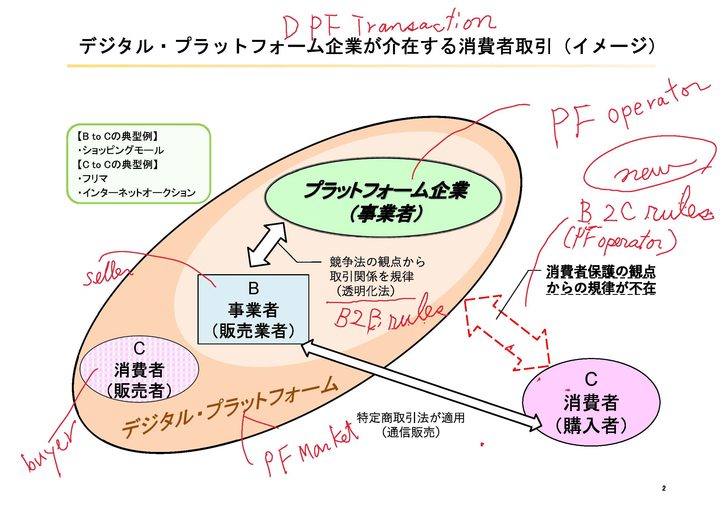
PDF Transaction Image

Slide 9
３ Current Status and Legal Framework of Platform Trading(1)
The Expansion of Platform Trading
The market for B2C-platform transactions in e-commerce continues to grow.
With the recent spread of smartphones, C2C-platform transactions are increasing through new services such as flea market apps and the sharing economy in addition to the already existing internet auctions.
The volume of not only B2C but also C2C transactions are growing rapidly. In particular, business models targeting personal transactions such as Mercari, using mechanisms that enable trading participation, are making it easier than ever for general consumers to act as providers of goods and services using flea market apps.

Slide 10
３ Current Status and Legal Framework of Platform Trading(2)
The Expansion of Platform Trading
According to statistics, the market size of B2C e-commerce reached JPY 17,9845 in 2018 (up 8.96% from the previous year).
Of this, the B2C market size for the sale of goods (products) was JPY 9,229.2 billion, of which transactions via smartphones made up JPY 3,655.2 billion (up 21.5% from the previous year; 39.3% of total product sales).
The market size of trading through flea market apps increased to JPY 639.2 billion in 2018 (JPY 483.5 billion in 2017) due to the spread of smartphones.

Slide 11
３ Current Status and Legal Framework of Platform Trading(3)
-Legal Mechanisms of Platform Trading
The PF Report considers the mechanism of platform trading by distinguishing what are referred to as B2C- and C2C-platforms.
Terminology: The contract for use between the platform operator and each user is called a platform usage contract (“usage contract”), while the contract between two users is called a user-to-user contract.
Under the B2C-platform transaction model, it is necessary to first conclude a usage contract (contract1) between C (consumer, user) and PF (platform operator). At this stage, a usage contract (contract 2) between B (business operator, user) and PF has already been established.
This basic mechanism creates the possibility of transactions that allow the transfer of property. A contract (contract 3) between the two parties will be concluded as a basis for this transfer of goods.

Slide 12
３ Current Status and Legal Framework of Platform Trading(4)
-Legal Mechanisms of Platform Trading
As for the C2C-platforms, the same relationships as explained just above can be found in this type of platforms:
A usage contract (1) between C1 (purchaser) and PF, as well as a usage contract (2) between C2 (provider) and PF are concluded.
The existence of these two usage contracts opens the possibility of a contract (3)(e.g., a sales contract, a service provision contract, etc.) being formed between C1 and C2.

Slide 13
３ Current Status and Legal Framework of Platform Trading(5)
-Legal Mechanisms of Platform Trading
Under the premise that platforms transactions take on this three-party contractual structure, the existence of the three contracts can be assumed for both the B2C- and the C2C-platforms and these contracts are interrelated in a conditional relationship.
From the perspective of consumer law, in C2C-platform transactions, the user contract between C1 and C2 is considered to be an individual transaction.
There is the danger that general consumer protection regulation loses its function.
If C2C-transaction troubles are classified as private disputes, it will not be possible to receive the support of consumer affairs centres.

Slide 14
4 How to Perceive the Liability of Platform Operators(1):
-Two Approaches
(A) Formal Approach
When regarding these relationships as formal three-sided contracts, it can be argued that each contract is separate. From the classical view that presupposes the relative effect of contracts, the platform operator does not, in principle, bear any contractual liability under the user-to-user contract.
This position emphasizes legal form.
The formal approach can be found in the “e-commerce rules”, according to which the platform operator is not principally responsible for user-to-user contracts, but may be exceptionally liable in certain cases only, depending on the state of "place". See METI, Interpretative Guidelines on Electronic Commerce and Information Property Trading (August 2020), available from https://‌www.meti.go.jp/‌english/‌press/‌2020/ 0828_008.html.

Slide 15
4 How to Perceive the Liability of Platform Operators(2):
Two Approaches
(B) Substantive Approach
A user-to-user contract can only be concluded with the intervention of a platform operator. All users must agree to the terms of use and they will be bound by these terms and conclude contracts with other users that include this content. Therefore, the three contracts are inter-related, and, moreover, closely related.
By establishing and providing such a system, platform operators are in a leading position (system provider responsibility).
The three-party contract can be seen as one within the framework of a compound or a combined contract and the responsibility of the platform operator as an integral part.

Slide 16
5 Some Remarks form the PF Report
The PF Report displays the following basic understanding: In platform trading, the platform operator — for the reason of increasing the number of users — provides a system (market) built around the terms of use determined and designed by it. Its users conduct transactions within the scope of this framework and matching is carried out.
The platform operator influences the decision-making process for concluding contracts between users and also plays an indispensable role in fulfilling the contract such as the execution of transactions between users.
The collection of information on its users enables platform operators to prevent trouble on the platform and avoid the incurrence of damage due to the exclusion of users who engage in illegal transactions.
The platform operator is in a position to build a system on the platform that allows users to 1) conduct transactions safely, and 2) secure opportunities for a rational selection.
It is important to take into account the perspective of consumers, who are important partners in the market.
The PF Report thus requires platform operators to incorporate consumer perspectives in building business models for platform trading.
The PF report does not directly propose legislative initiatives to regulate platform trading, but, as a premise for this, investigates the status of current efforts in terms of the roles of the parties involved in platform trading and summarizes the results.

Slide 17
6 Current legislative status(1)
Regarding B2B on DPFs, there is Law Concerning the Improvement of Transparency and Fairness of Specified Digital Platforms enacted in May 2020, and enforced in February 1, 2021）
・The law is of a similar system to EU law, which was enacted last year from the perspective of competition law, but I will not mention details here.
A new legislation on DPF was enacted very recently for B2C. Act on Protection of The Interests of Consumers Using Trading Digital Platforms(May 10, 2021, Law No. 32)
Enforced from the date specified by a Cabinet Order within a range not exceeding one year from the date of promulgation.
The law was deliberated and drafted by the Consumer Affairs Agency's review committee.
The contents will be introduced below.

Slide 18
6 Current legislative status(2)
Summary: In transaction digital platforms (transaction DPF) such as online malls, problems such as distribution of dangerous products and sellers cannot be identified easily, and dispute resolution becomes difficult. In response to this, laws were established to protect consumer interests.
1 Obligation of DPF providers to make efforts (Article 3)
2 Suspension of listing of products, etc. (Article 4)
3 Right to request disclosure of information pertaining to distributors (Article 5)
4 Public-private councils (Articles 6-9)
5 Consumer Application System (Article 10)

Slide 19
6 Current legislative status(3)
1 Obligation of DPF providers to make efforts (Article 3)
• In order to contribute to the optimization of mail-order transactions (BtoC transactions) conducted using the DPF and the promotion of dispute resolution, we have established an obligation to make efforts to implement the following measures (1) to (3) and disclose their outlines. (A guideline is formulated for specific contents).
1) Take measures that enable smooth communication between distributors and consumers.
2) Conduct necessary investigations, etc. when a complaint is received regarding the display of sales conditions, etc.
3) Request the distributor to provide information for identification as necessary.

Slide 20
6 Current legislative status (4)
2 Suspension of listing of products, etc. (Article 4)
The Prime Minister may request the transaction DPF provider to delete the listing, etc. when dangerous products, etc. are listed and it is difficult to enforce individual laws, such as in cases where the seller cannot be specified .
The transaction DPF provider is exempted from liability for any damage caused to the seller by responding to the request.

Slide 21
6 Current legislative status(5)
3 Right to request disclosure of information pertaining to distributors (Article 5)
Created the right to request disclosure of merchant information to the extent necessary for consumers to make claims for damages, etc.
The DPF provider is not responsible to the seller if it responds to the disclosure request in accordance with appropriate procedures.
If the amount of the claim for damages is less than a certain amount or the claim is for an illegal purpose, this disclosure request right is not eligible.

Slide 22
6 Current legislative status(6)
4 Public-private councils (Articles 6-9)
Establish public-private councils composed of national administrative agencies, organizations consisting of DPF providers, consumer organizations, etc., and discuss matters that each entity should address, such as responding to unscrupulous distributors, etc.
5 Consumer Application System (Article 10)
Consumers, etc. may request the Prime Minister (Consumer Affairs Agency) to take appropriate measures to cause consumer damage.

Slide 23
Thank you for your attention
Kunihiro Nakata
Final Remarks
In addition, a review during the third year after enforcement of this law has been stipulated, taking into account changes in the status of enforcement and economic and social conditions.
The law does not provide for the civil liability of digital platform operator and also the regulation of C2C transaction.
Civil liability provisions of digital platform for B2C transaction can be found in neighboring legislation such as those of China and South Korea.
The day when such an amendment for the civil liability of digital platform will be made in Japan may be near.

