Slide 1

Prospects For Virtual Hearings
Going Virtual for Good?

Slide 2
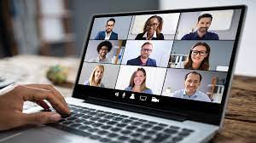
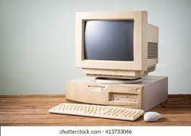
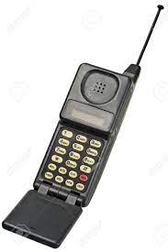
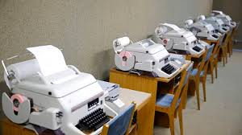
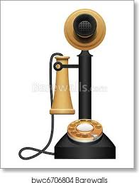
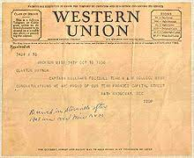

Where we’ve come from

Slide 3
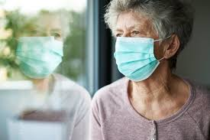
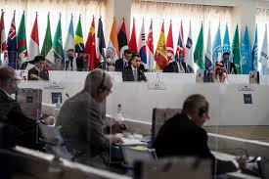
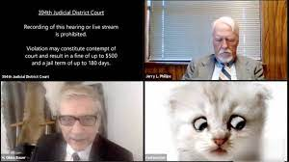
Where we’ve been lately

Slide 4
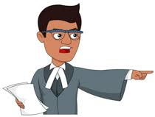
Preparing witnesses Examining witnesses Showing documents to witnesses and tribunal Demonstrating integrity of the testimony Adjusting advocacy styles

Slide 5

Testifying alone In comfortable surrounds Without assistance

Slide 6

Managing the proceedings Following the evidence Onscreen stamina

Slide 7
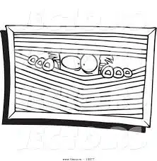
The Parties

Slide 8
The future is bright
Greener disputes
Improved efficiencies
Better public access
Improved records

